Slide 1



Glass Manufacturing
& Warehouse Management System
(With Automation)
Internal Guide : Dr. Harish Morwani
Developed At : BizzAppDev Systems Pvt Ltd.
Developed By : Divya Nayi [23CI2110071] Tanishq Nayak [23CI2110070] Devansh Patel [23CI2110086]

Slide 2

Project Profile
Project Title : | Glass Manufacturing & Warehouse Management System (With Automation)
Project Category : | Enterprise Resource Planning.
Group No : | 34

Slide 3

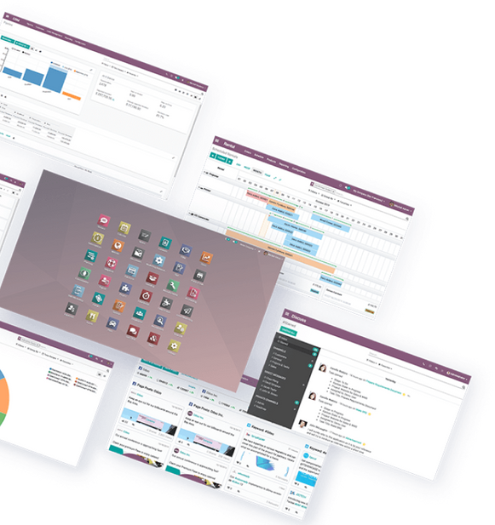
Introduction
Odoo is a versatile business management tool offering apps for accounting, sales, inventory, human resource, and more.

Slide 4
Tools & Technologies
Front-end : | XML, HTML, JS
Back-end : | Python
Framework : | Odoo
Database : | PostgreSQL
Browser : | Chrome, Safari, Edge etc.

Slide 5
Project Scope
Manufacturing
Warehouse Management
Automation

Slide 6
Objectives
Streamline Warehouse Operations
Improve Inventory Accuracy
Optimize Stock Levels
Enhance Order Processing
Increase Productivity
Provide Real-Time Insights

Slide 7
Deliverables
Automated Inventory System
Barcode-Based Picking and Location Assignment
Integrated Manufacturing & Warehouse System
Efficiency And Accuracy Dashboard
Real-Time Inventory Visibility
Automatic Inventory Updation
Integration with IOT

Slide 8
Existing System
Inventory Management
Order Management
Shipping Management

Slide 9
Gaps Of Existing System
Manually Manage Inventory
High Implementation Cost
Difficult User Interface
Limited Customization
Basic Reports

Slide 10
Client Requirements
Tailored Process
Value Tracking
Glass Availability Check
Order Fulfillment
Delivery Integration

Slide 11
Diagrams

Slide 12
Use Case
Activity Diagram

Slide 13
Remote User Sequence Diagram
Warehouse Sequence Diagram

Slide 14
Glass Manufacturer Sequence Diagram
Class Diagram

Slide 15
Data Dictionary

Slide 16
Sale Order
Name | Data Type | Size | Constraint | Description
id | Integer | 10 | Primary Key | Unique identifier for the sale order.
partner_id | Integer | 5 | Foreign Key | Reference of the customer who placed the order.
user_id | Integer | 5 | Foreign Key | Reference of the salesperson responsible for the order.
warehouse_id | Integer | 5 | Foreign Key | Reference of the warehouse from which the products are shipped.
payment_term_id | Integer | 5 | Not Null | Reference of the payment terms for the sale order.
name | Char | 20 | Not Null | The unique name/number of the sale order.
date_order | DateTime | - | Not Null | The date and time when the sale order was created.
state | Selection | 5 | Not Null | The current state of the sale order (e.g, draft, sent, sale, done, cancel).
amount_total | Float | 7 | Not Null | The total amount of the sale order including taxes.
amount_untaxed | Float | 10 | Not Null | The total amount of the sale order excluding taxes.
amount_tax | Float | 7 | Not Null | The total tax amount for the sale order.
validity_date | Date | - | - | The expiration date of the sale order.
note | String | 150 | - | Any additional notes or comments for the sale order.

Slide 17
2. Sale Order Item
Name | Data Type | Size | Constraint | Description
id | Integer | 10 | Primary Key | Unique identifier for the sale order line.
order_id | Integer | 5 | Foreign Key | Reference of the sale order (sale.order) to which this line belongs.
product_id | Integer | 5 | Foreign Key | Reference of the product (product.product) being sold.
product_uom_qty | Float | 7 | Not Null | The quantity of the product ordered.
product_uom | Integer | 5 | Not Null | Reference of the unit of measure (uom.uom) of the product.
price_unit | Float | 10 | Not Null | The unit price of the product.
price_subtotal | Float | 10 | Not Null | The subtotal for the order line excluding taxes.
price_total | Float | 10 | Not Null | The total for the order line including taxes.
name | String | 50 | Not Null | Name of the product.
tax_id | Integer | 5 | Not Null | List of taxes (account.tax) applied to the order line.

Slide 18
3 . Product Details
Name | Data Type | Size | Constraint | Description
id | Integer | 10 | Primary Key | Unique identifier for the product.
uom_id | Integer | 5 | Foreign key | Reference of default unit of measure for all stock operation.
categ_id | Integer | 5 | Foreign Key | Reference of different product category id.
name | Char | 20 | Not Null | Name of the product.
description | String | 150 | - | Description of the product details.
detailed_type | Selection | 15 | Not Null | Type of the product details.
image_1920 | Binary | 50 | - | Image of the product.
list_price | Float | 10 | Not Null | Sale price of the product.
standard_price | Float | 10 | Not Null | Standard value of the product.
taxes_id | Float | 5 | Not Null | Default tax id on the selling product
product_tag_ids | Integer | 5 | - | Tag id of the product template.

Slide 19
4 . Product Category
Name | Data Type | Size | Constraint | Description
id | Integer | 5 | Primary Key | Unique identifier for the product category.
name | Char | 50 | Not Null | Name of the product category.
description | String | 150 | - | Description of the product category.
image_1920 | Binary | 50 | - | Image of the product category.
product_count | Integer | 10 | - | Count of products variants.
use_expiration_date | Boolean | 2 | - | Indicates whether products in this category use an expiration date.
expiration_time | Integer | 5 | - | Number of days after which the product is considered expired.
use_time | Integer | 5 | - | Number of days after which the product is considered to be at its best before time.
removal_time | Integer | 5 | - | Number of days after which the product should be removed from inventory.
alert_time | Integer | 5 | - | Number of days before the expiration date when an alert should be triggered.
additional_customer_lead_time | Integer | 5 | Not Null | Illustrate the value of additional customer lead time.

Slide 20
5 . Receipts
Name | Data Type | Size | Constraint | Description
id | Integer | 15 | Primary Key | Unique identifier for the receipt.
partner_id | Integer | 5 | Foreign Key | Reference of the partner who is the supplier or customer.
location_id | Integer | 5 | Foreign Key | Reference of the source location for the receipt.
location_dest_id | Integer | 5 | Foreign Key | Reference of the destination location for the receipt.
picking_type_id | Integer | 5 | Foreign Key | Reference of the picking type indicating the operation type.
company_id | Integer | 5 | Foreign Key | Reference of the company associated with this receipt.
user_id | Integer | 5 | Foreign Key | Reference of the user responsible for the receipt.
batch_id | Integer | 5 | Foreign Key | Reference of the batch if the receipt is part of a batch.
name | Char | 20 | Not Null | The unique name/number of the receipt.
origin | Char | 20 | Not Null | Reference of the source document (e.g., sale order, purchase order).
scheduled_date | DateTime | - | - | The scheduled date and time for the receipt.
date_done | DateTime | - | - | The actual date and time when the receipt was completed.
move_ids | Integer | 5 | - | List of stock moves associated with the receipt.

Slide 21
6 . Stock
Name | Data Type | Size | Constraint | Description
id | Integer | 5 | Primary Key | Unique identifier for the stock.
product_id | Integer | 5 | Foreign Key | Reference of the product.
inventory_diff_quantity | Integer | 5 | - | Quantity difference during inventory adjustment.
location_id | Integer | 5 | Foreign Key | Reference of the source location of the stock.
company_id | Integer | 5 | Foreign Key | Reference of the company associated with the stock.

Slide 22
7. Manufacturing Order
Name | Data Type | Size | Constraint | Description
id | Integer | 11 | Primary Key | Unique identifier for the manufacturing order.
product_id | Integer | 5 | Not Null | Reference of the product.
location_id | Integer | 10 | Not Null | Reference of the location.
components_availability | Char | 5 | Not Null | Indicates the availability status of components required for manufacturing.
bom_id | Integer | 5 | Not Null | Bill of Materials (BOM) identifier associated with the work order.
date_start | Datetime | - | Not Null | Date and time when the product manufacturing started.
date_finished | Datetime | - | Not Null | Date and time when the product manufacturing was completed.

Slide 23
8 . Partner Details
Name | Data Type | Size | Constraint | Description
id | Integer | 5 | Primary Key | Unique identifier of the partner.
parent_id | Integer | 5 | Not Null | Reference of the parent partner.
company_id | Integer | 5 | Not Null | Reference of the partner’s company.
branch_code | Char | 50 | Not Null | Branch code associated with the partner.

Slide 24
9. Delivery Order
Name | Data Type | Size | Constraint | Description
id | Integer | 11 | Primary Key | Unique identifier for the delivery order.
partner_id | Integer | 5 | Not Null | Reference of the partner.
location_id | Integer | 10 | Not Null | Reference of the location.
scheduled_date | DateTime | - | Not Null | Scheduled date and time for the first part of the shipment.
date_deadline | DateTime | - | Not Null | Deadline date and time for the delivery.
products_availability | Selection | 10 | Not Null | Availability status of the products.
sale_id | Integer | 5 | Not Null | Reference of the related sale order.

Slide 25
10. Glass Order
Name | Data Type | Size | Constraint | Description
id | Integer | 11 | Primary Key | Unique identifier of the glass order.
product_id | Integer | 5 | Not Null | Reference of the product.
sale_order_id | Integer | 5 | Not Null | Reference of the sale order.
sale_line_id | Integer | 5 | Not Null | Reference of the sale line.
state | Selection | 5 | Not Null | Current state/status of the glass order.
glass_order_count | Integer | 5 | - | Total number of glass orders.
glass_shipping_id | Integer | 5 | Not Null | Unique identifier of the glass shipment.

Slide 26
11 . Picking Component
Name | Data Type | Size | Constraint | Description
id | Integer | 11 | Primary Key | Unique identifier of the picking components of manufacturing order.
product_id | Integer | 5 | Not Null | Reference of the product.
product_uom_qty | Integer | 5 | Not Null | Quantity of the product unit of measure.
uom_id | Integer | 5 | Not Null | Reference of the unit of measure.
location_id | Integer | 10 | Not Null | Reference of the location.
workcenter_id | Integer | 10 | Not Null | Reference of the destination location.
origin | Char | 20 | Not Null | Reference document related to manufacturing order..
direct_invoice_id | Many2one | 5 | Foreign key | Reference to the invoices table or account_move table.

Slide 27
System Screenshots

Slide 28
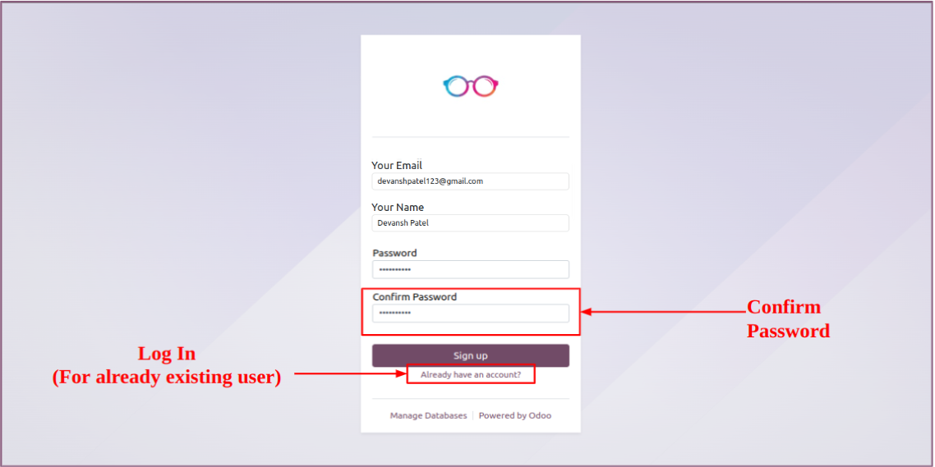
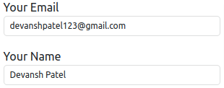
Registration Page

Slide 29
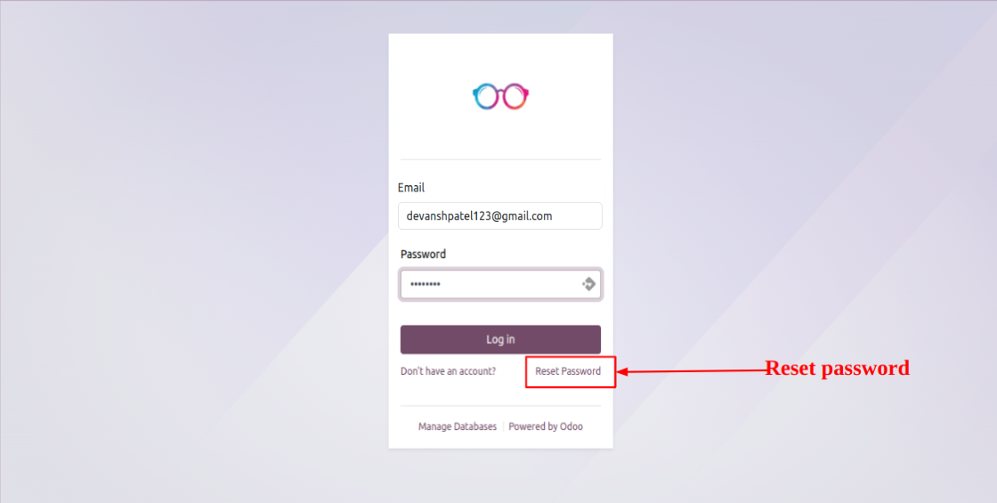
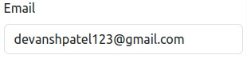
Login Page

Slide 30
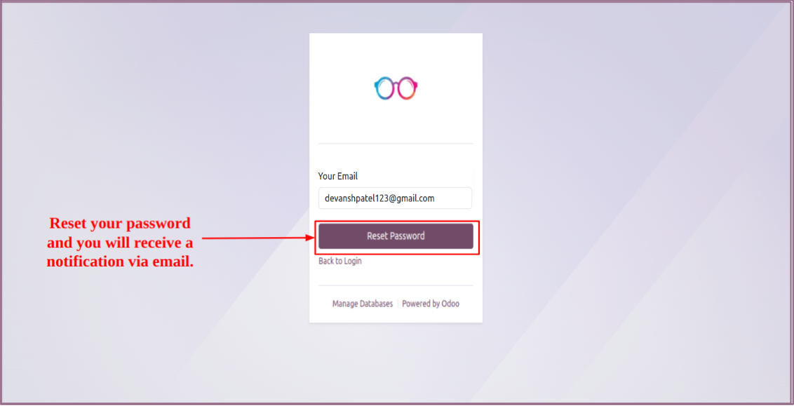
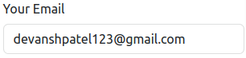
Reset Password

Slide 31
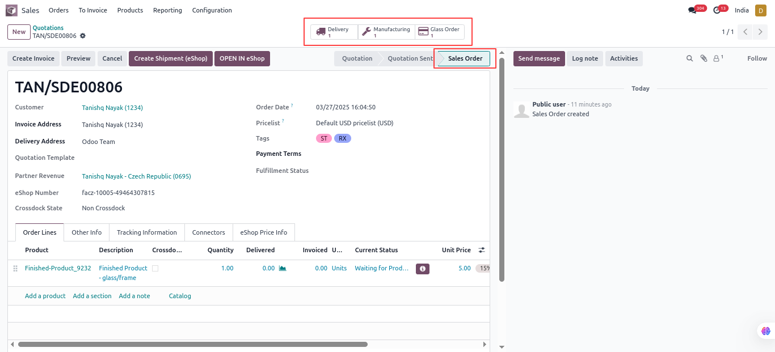
Sale Order (Confirmed)

Slide 32
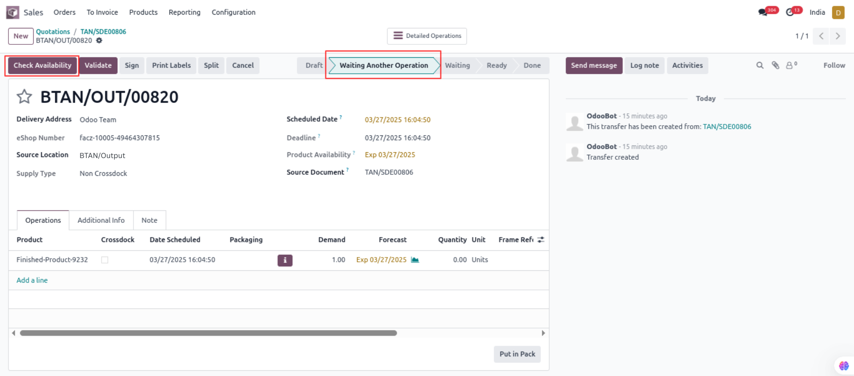
Delivery Order (Waiting State)

Slide 33
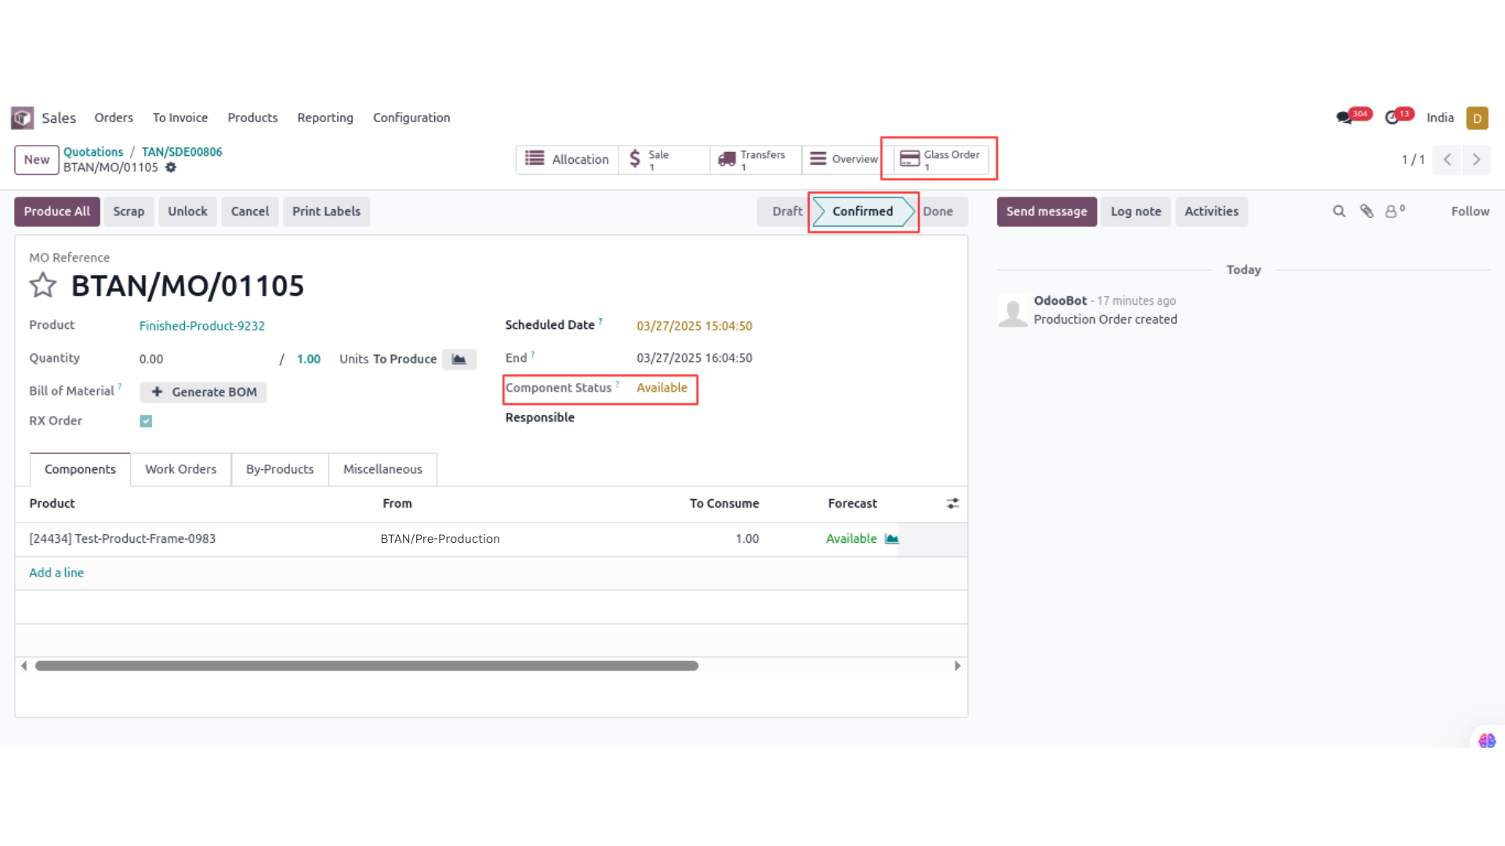
Manufacturing Order (Confirmed)

Slide 34
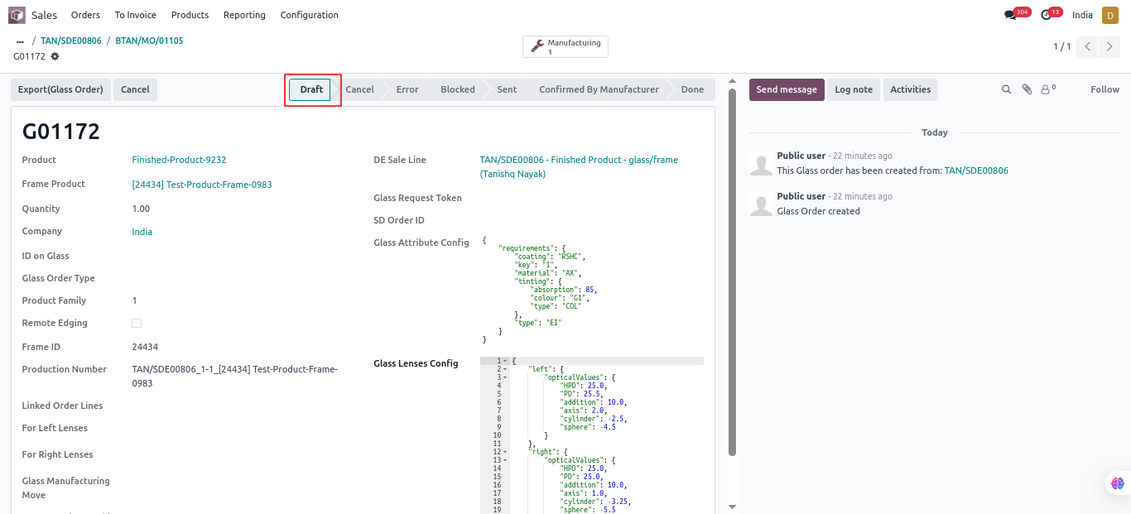
Glass Order (Draft State)

Slide 35
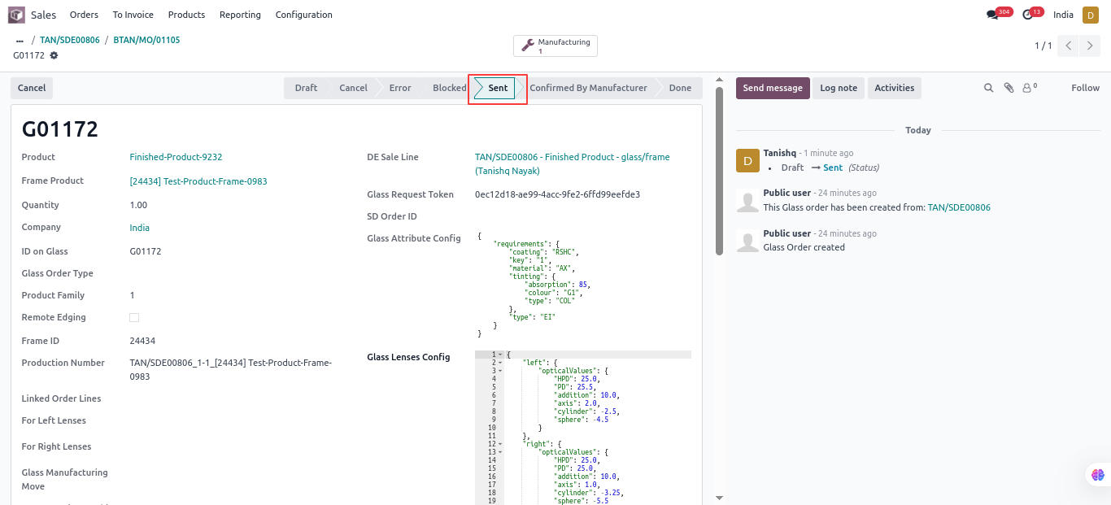
Glass Order (Sent State)

Slide 36
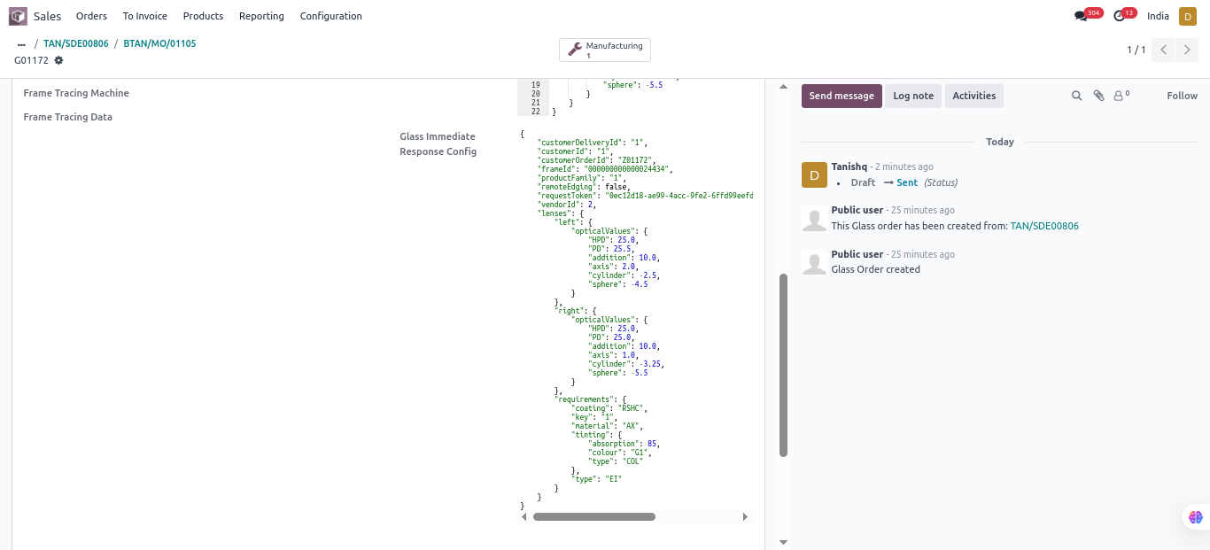
Glass Order (Sent)

Slide 37
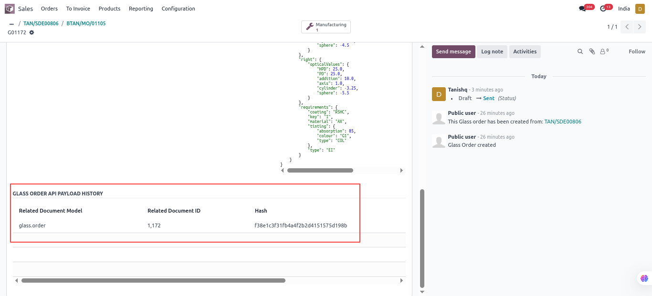
Glass Order (Sent History)

Slide 38
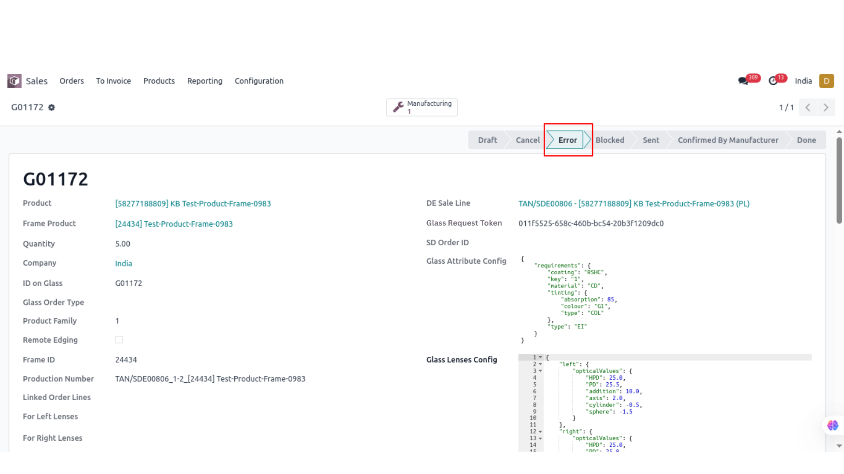
Glass Order (Error State)

Slide 39
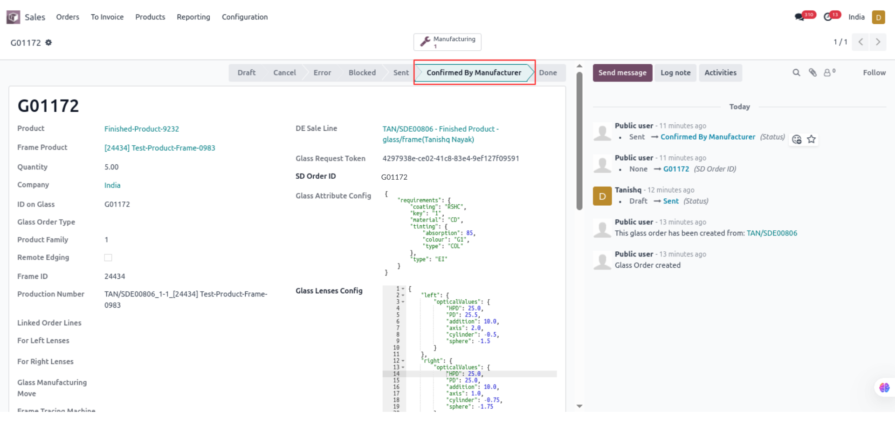
Glass Order (Confirmed)

Slide 40
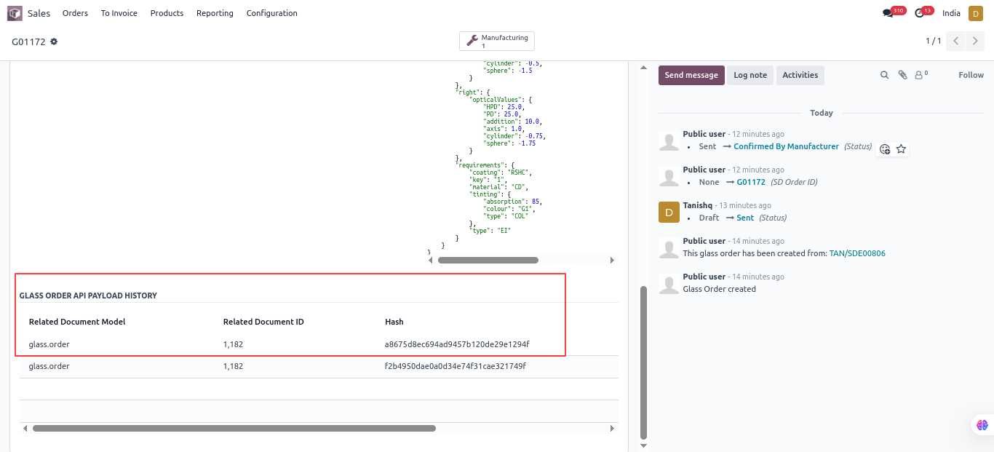
Glass Order (Confirmed History)

Slide 41
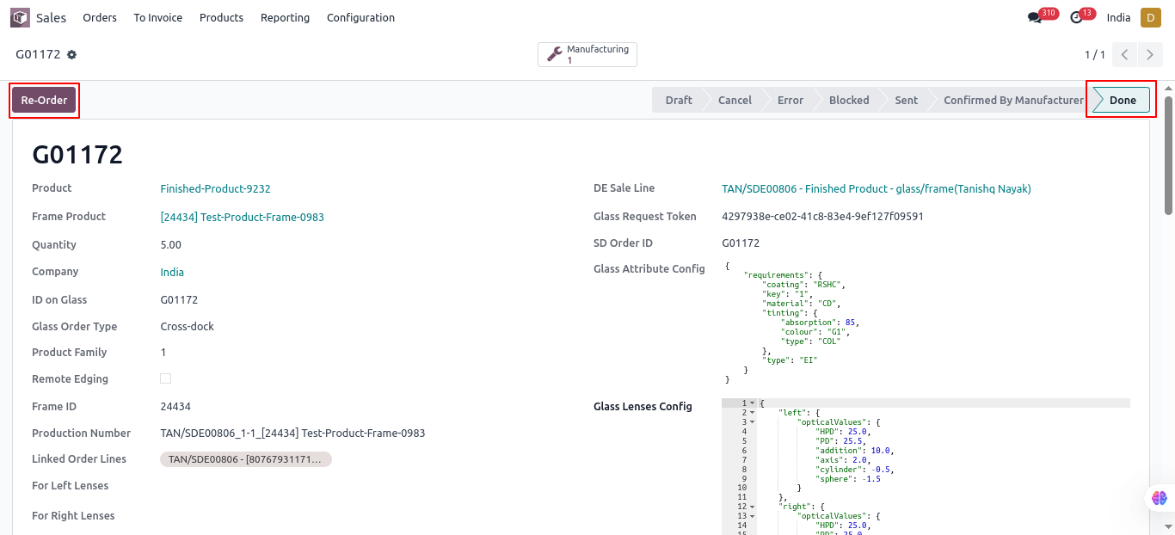
Glass Order (Done State)

Slide 42
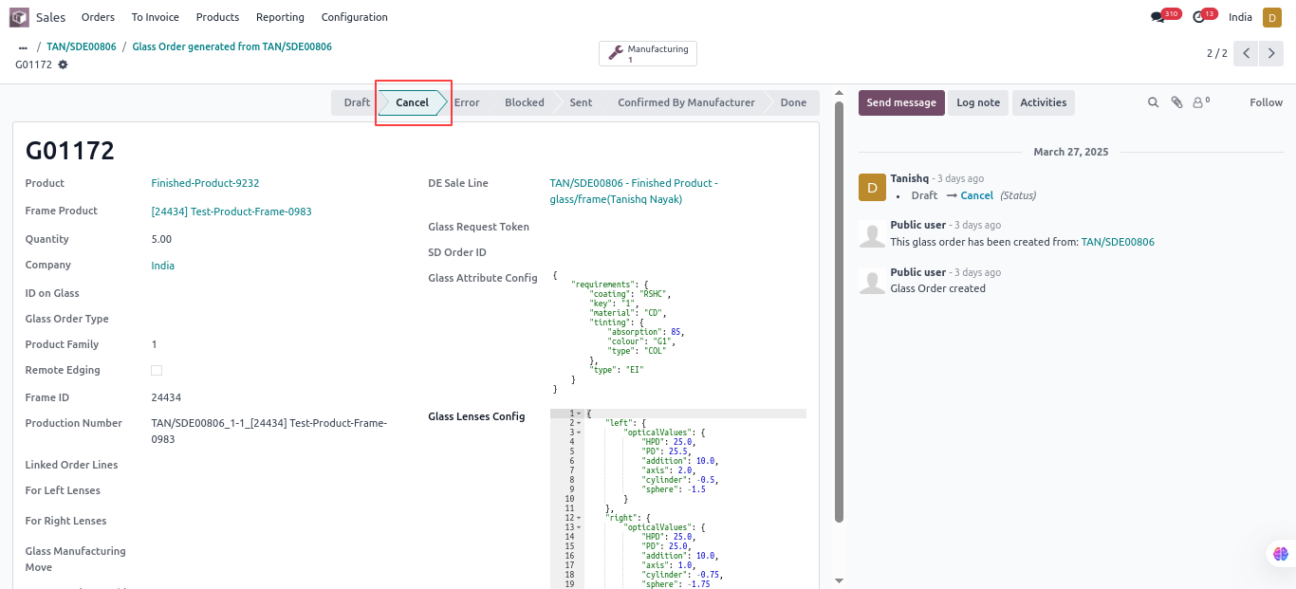
Glass Order (Cancel State)

Slide 43
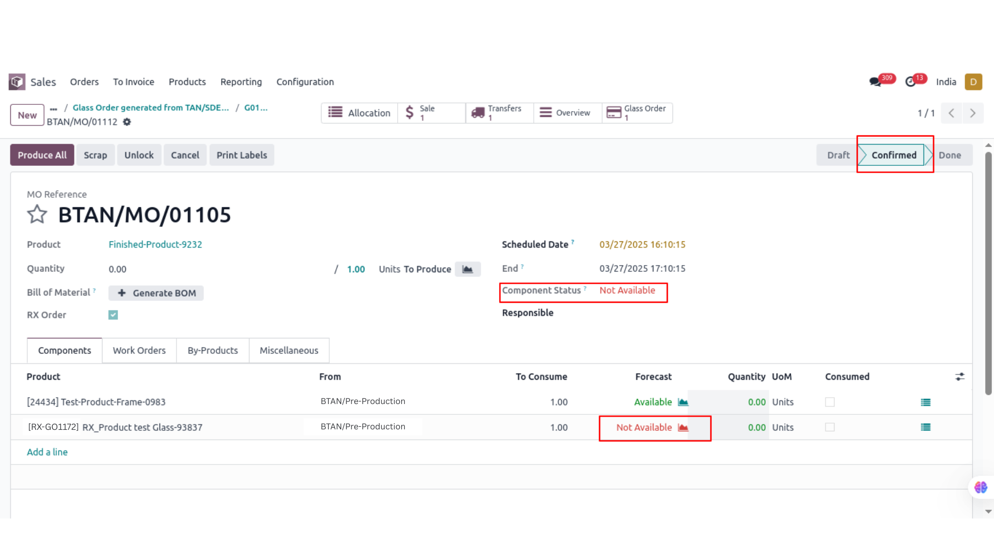
Manufacturing Order(Component - Not Available)

Slide 44
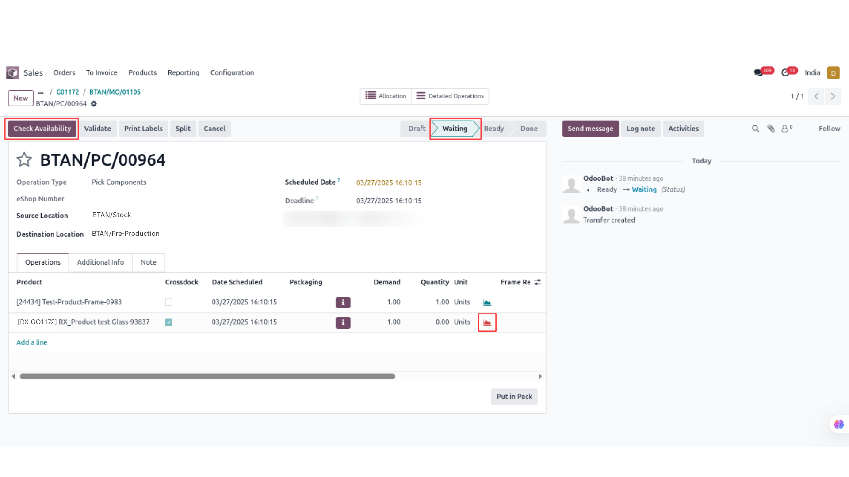
Picking Component (Waiting State)

Slide 45
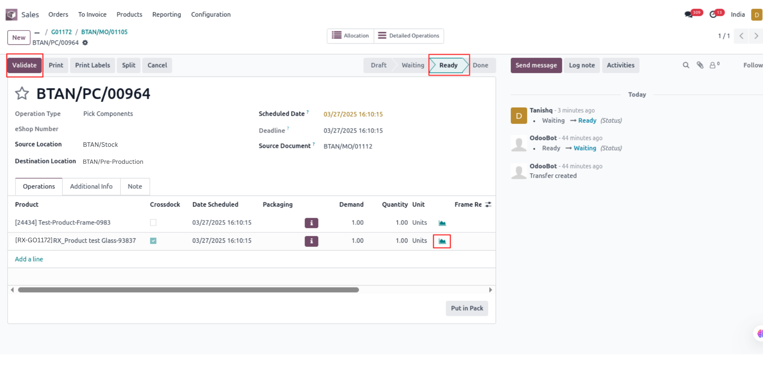
Picking Component (Ready State)

Slide 46
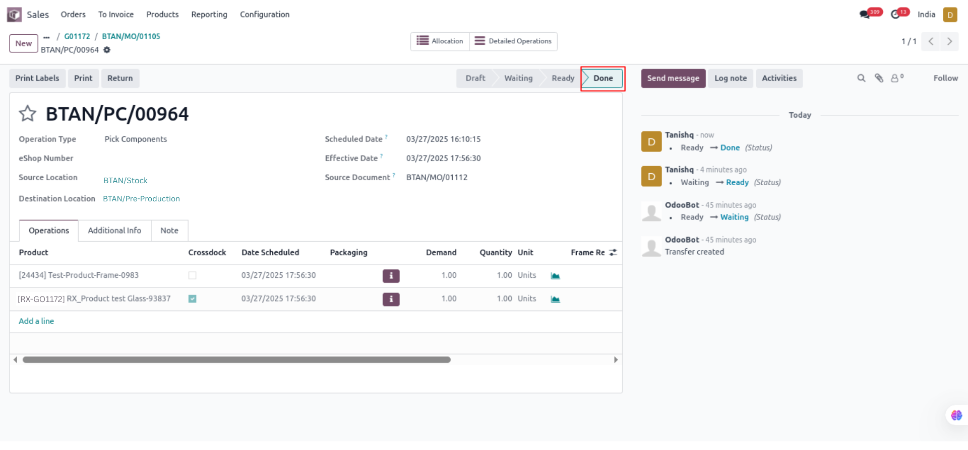
Picking Component (Done State)

Slide 47
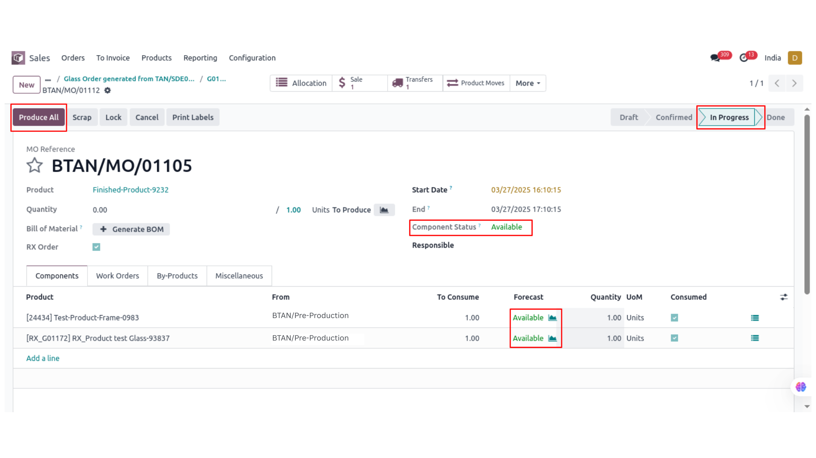
Manufacturing Order(Component - Available / In progress State)

Slide 48
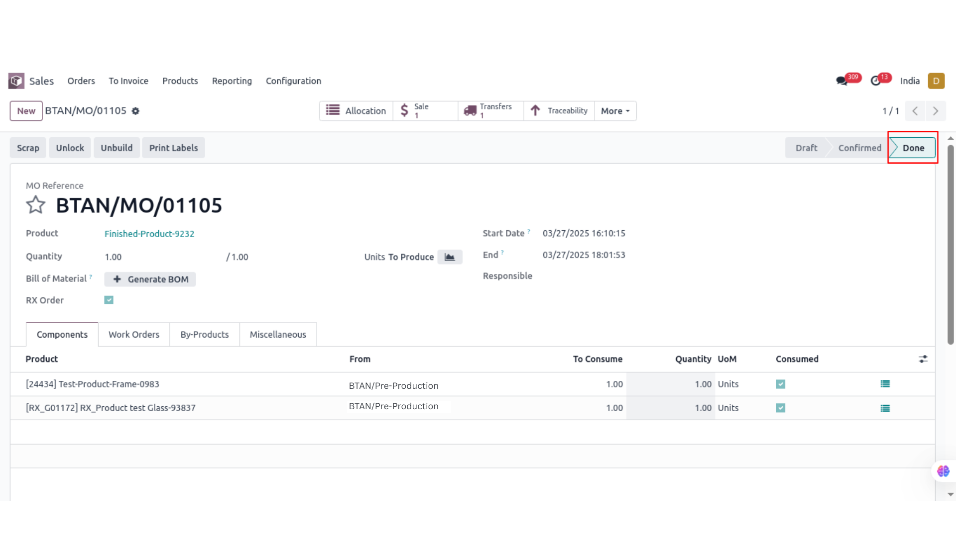
Manufacturing Order(Done State)

Slide 49
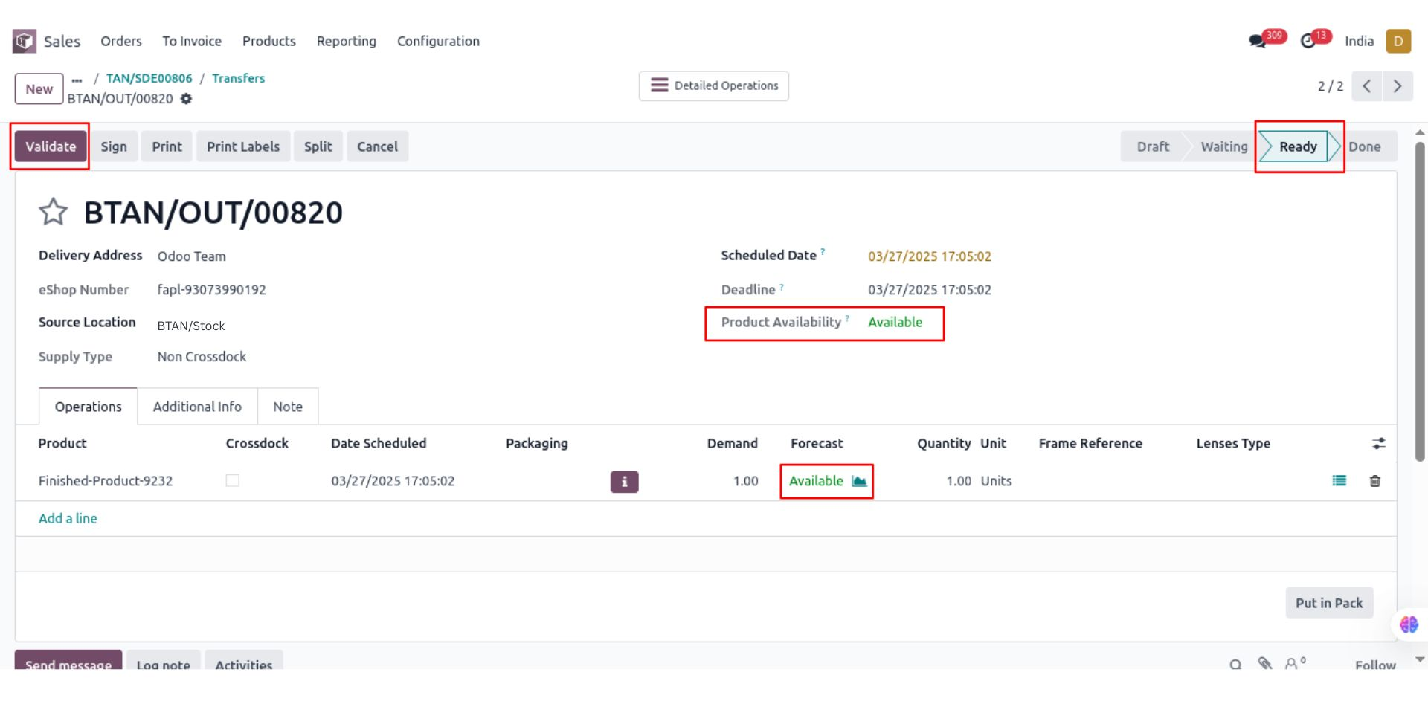
Delivery Order (Ready State)

Slide 50
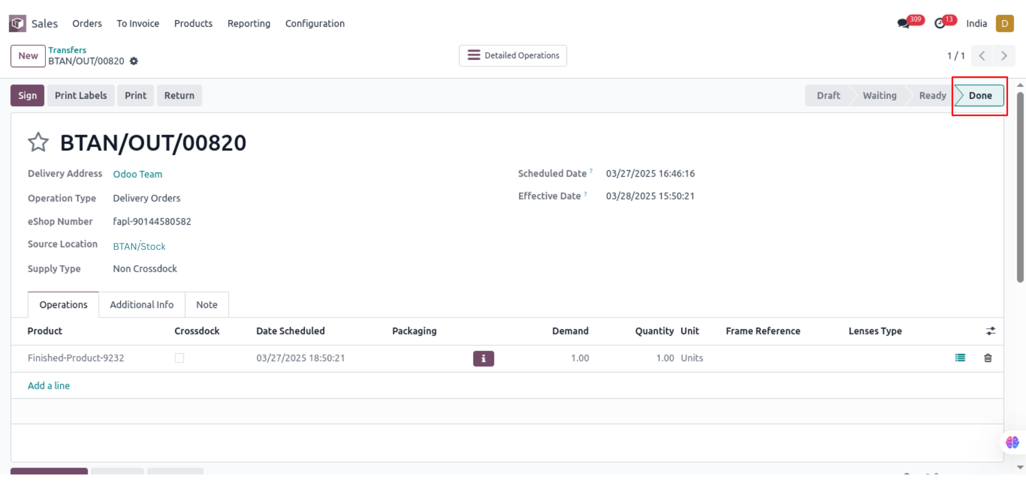
Delivery Order (Done State)

Slide 51
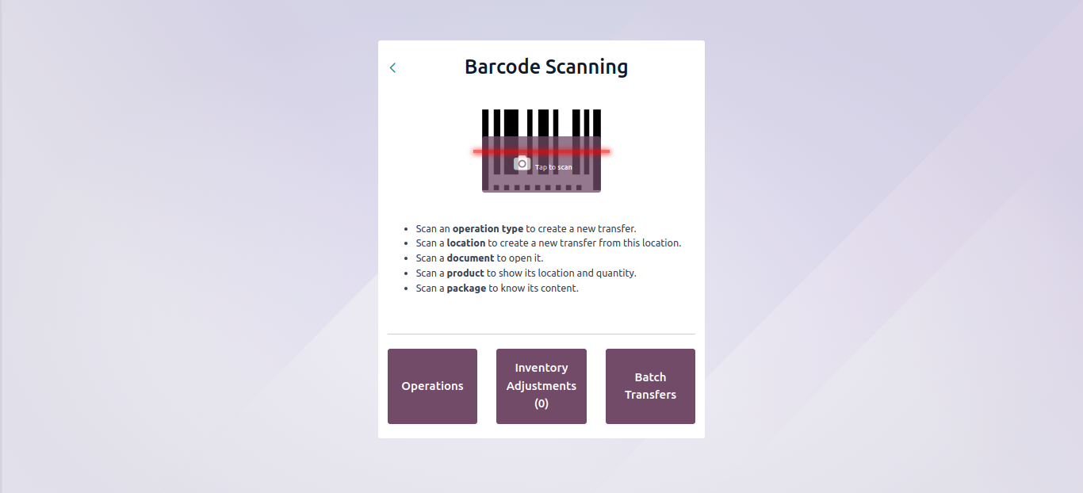
Barcode Module

Slide 52
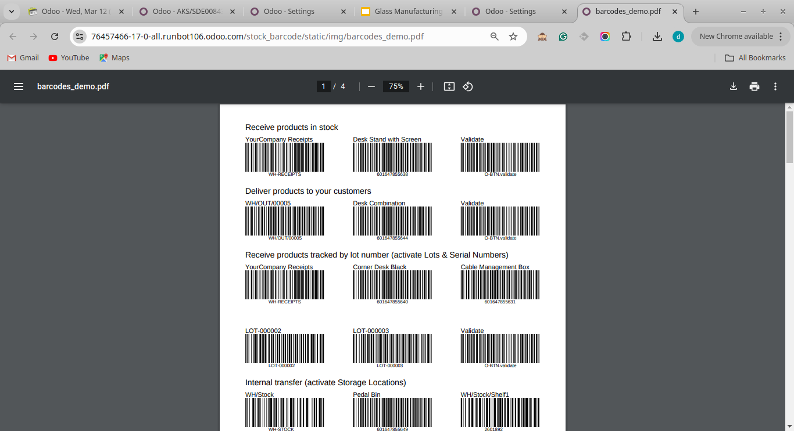
Barcode Demo PDF

Slide 53
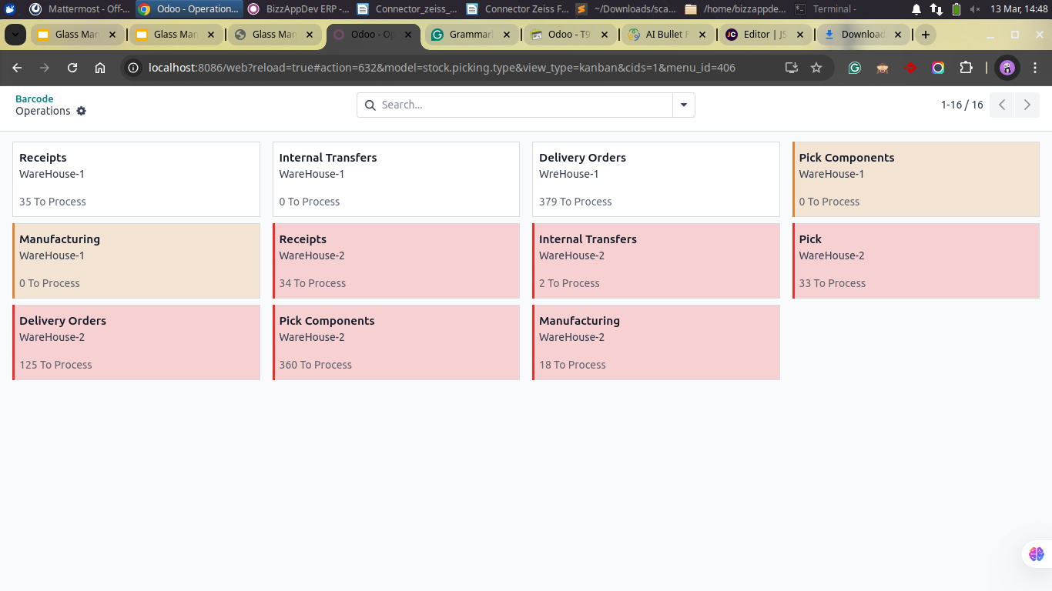
Barcode Operations

Slide 54
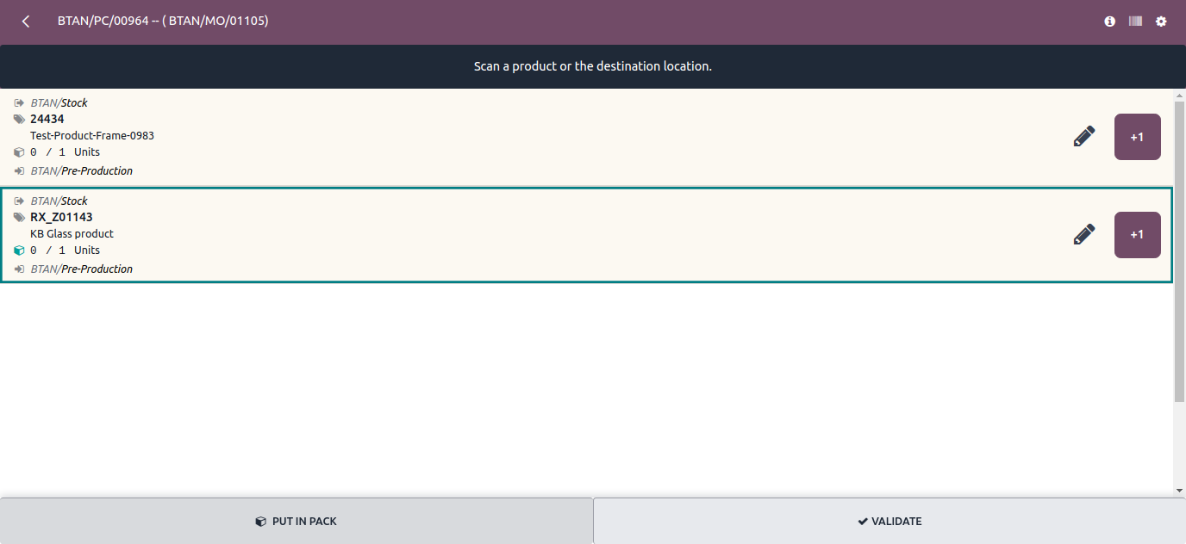
Picking Components

Slide 55
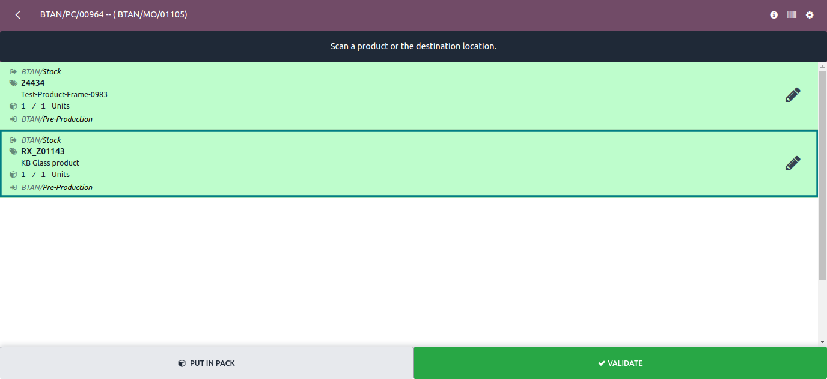
Scan Product

Slide 56
Picking (Validate)

Slide 57
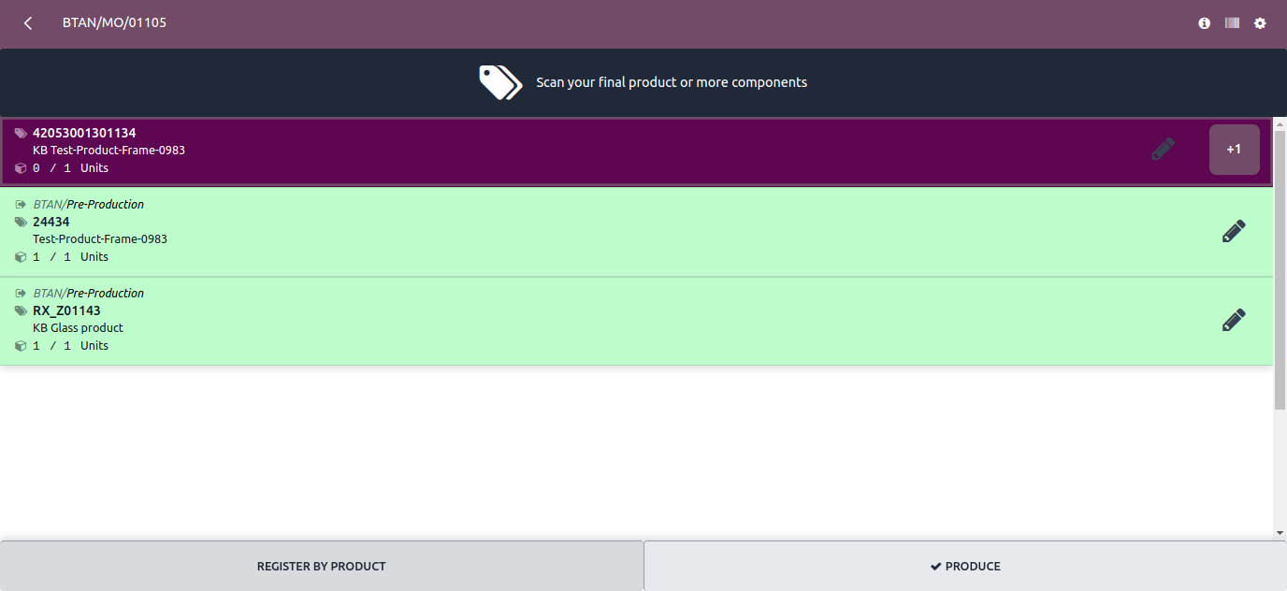
Scan Manufacturing Order

Slide 58
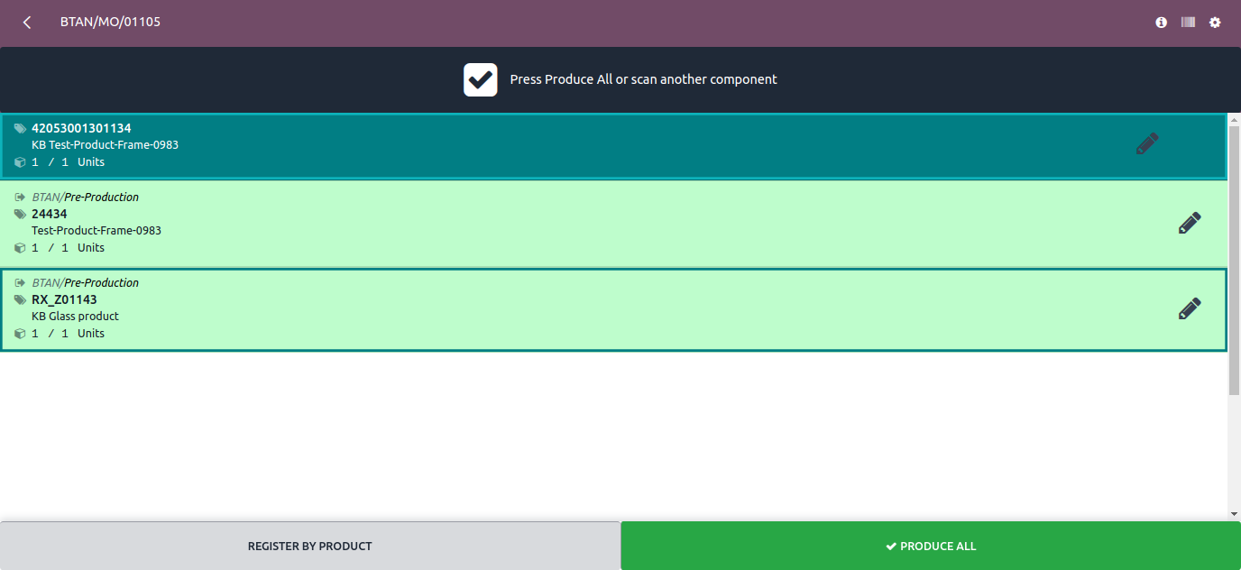
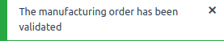
Manufacturing Order (Validate)

Slide 59
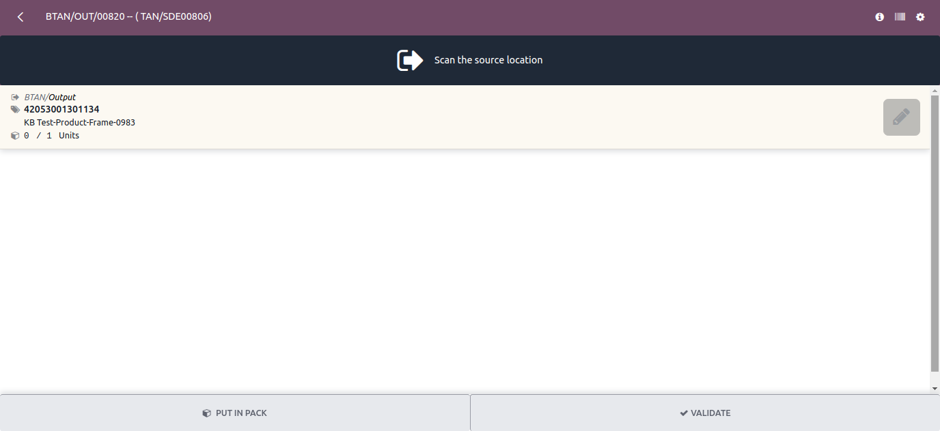
Delivery Order

Slide 60
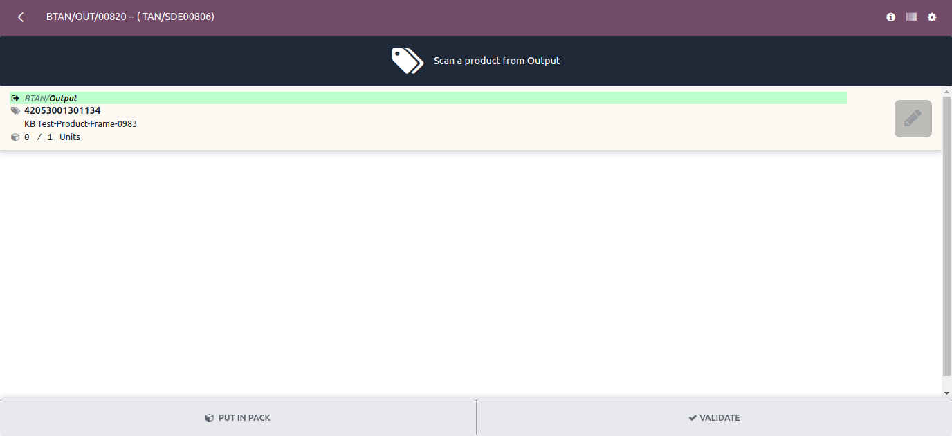
Scan Source Location

Slide 61
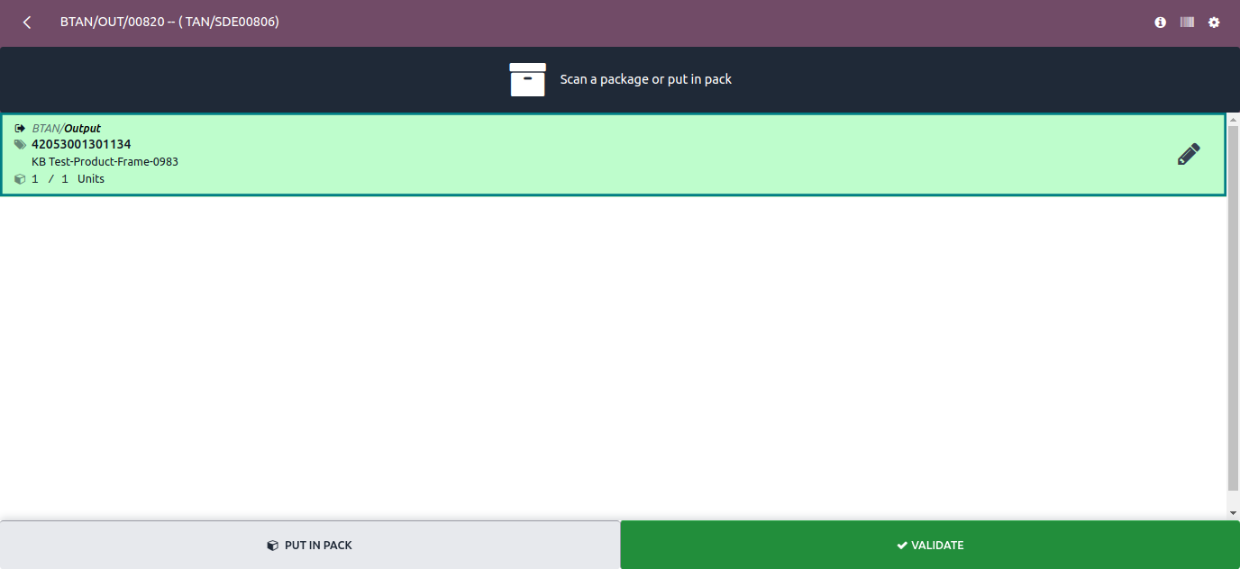
Scan Product

Slide 62
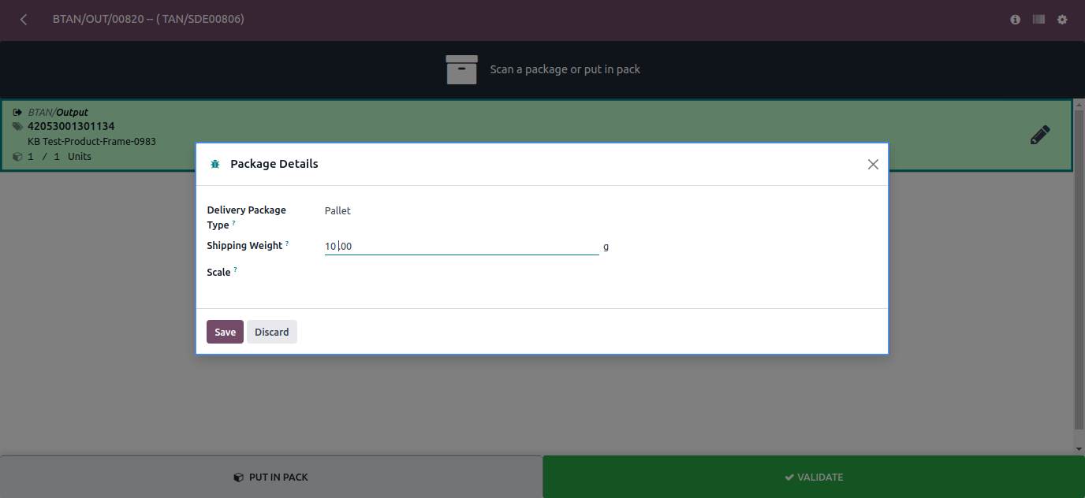
Scan a package or put in pack

Slide 63
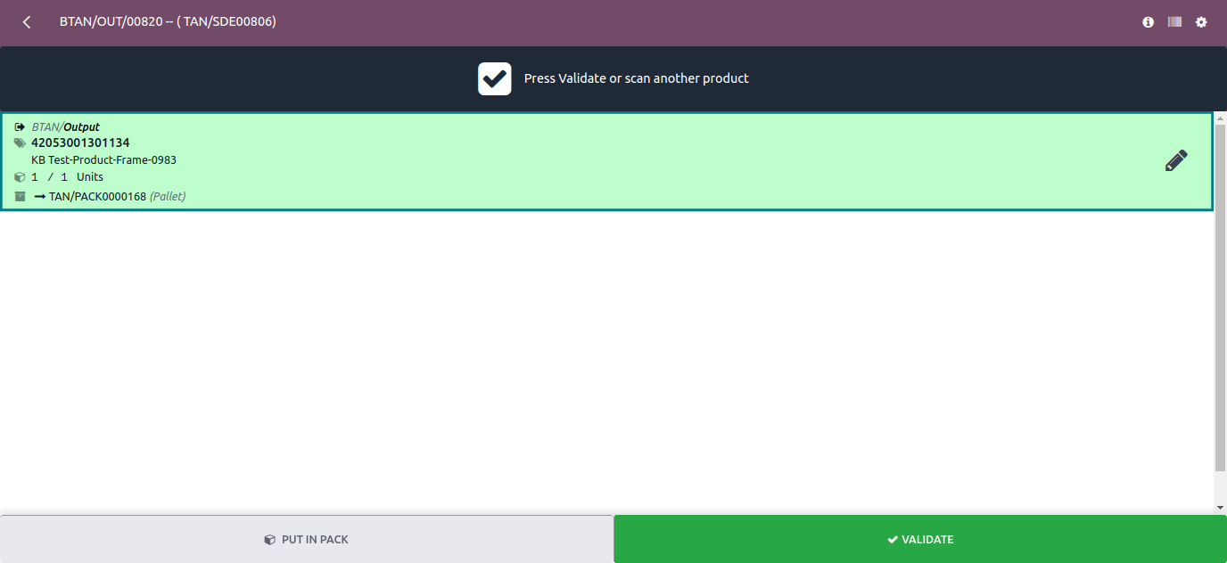
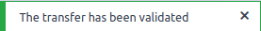
Delivery Order (Validate)

Slide 64
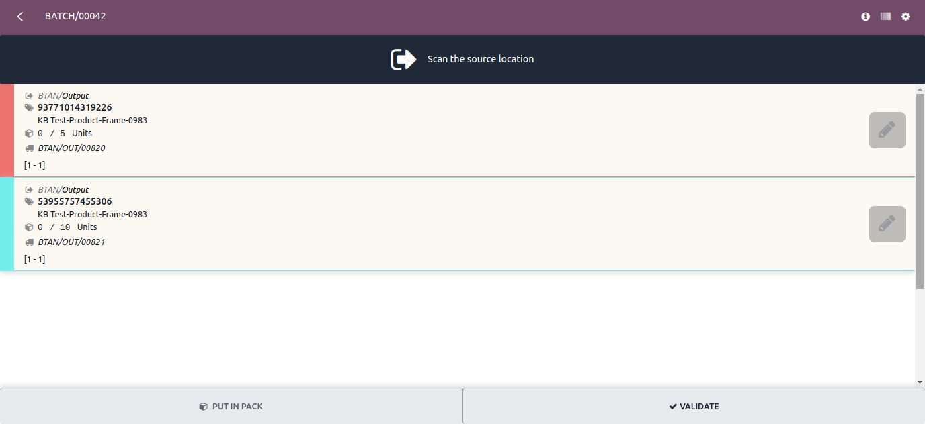
Batch Transfer

Slide 65
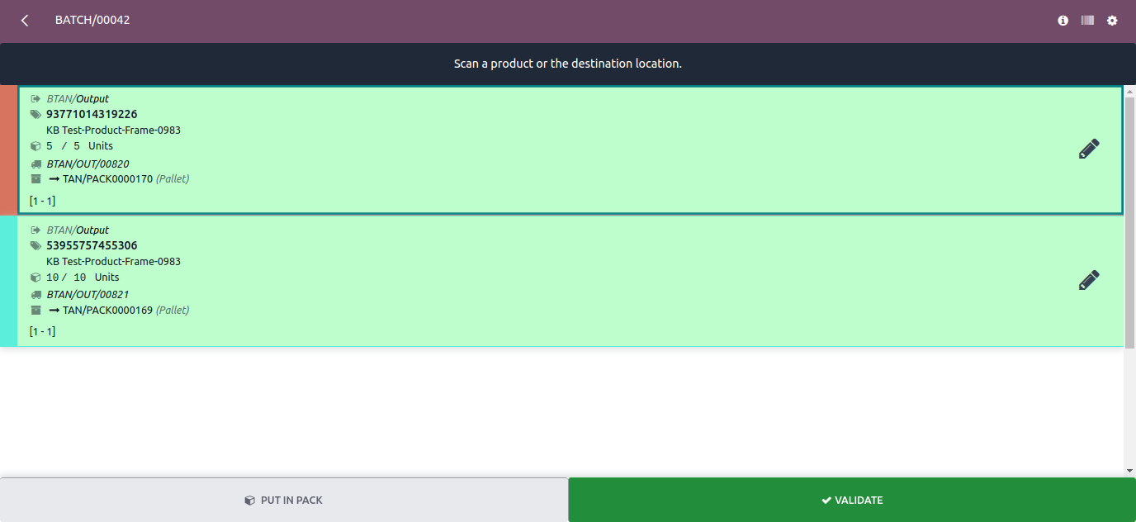
Scan product

Slide 66
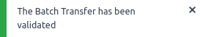
Batch Transfer (Validated)

Slide 67
Thank You

